Slide 1

Smart Traffic Controller
David Addai

Slide 2

Outline
Traffic Congestion problem
Existing Implemented solutions
Shortfall of the existing traffic light control systems
Smart Traffic Controller as a solution
CCSE 2022
1

Slide 3
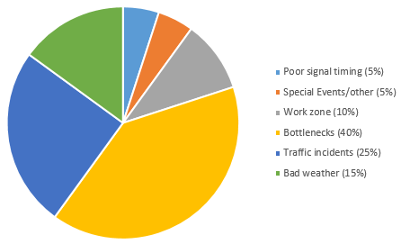
Overview
Problem Overview
Traffic Congestion
Engineering constructions not enough slotions
Poor signal timing of controllers
System Overview
Major components
• Arduino Mega 2560 micro-controller – Processes the sys logic • IR sensors – Detect and send signal to the controller unit as counter input • PIR-based motion detectors – Detect pedestrian. Send signal to the controller unit
- Install at pedestrian crossing waiting points
Ref: [1]
2
CCSE 2022

Slide 4
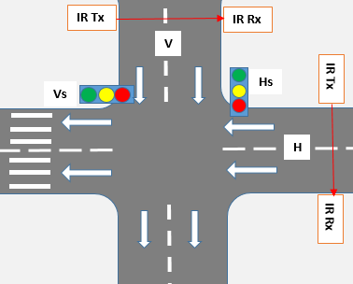

System Design
Operates in 4 Transition Modes
Normal mode – Under normal traffic condition and system start
Equal time slots for all directions
Start counter after one cycle
Check “vehicleCounter” value within normal range (>=minNormal && <=maxNormal)
Then reset counters
Congestion mode – Under intense traffic condition
Any “vehicleCounter” value above normal threshold (>maxNormal)?
Extend “green time slot” for congested road
Base on time to exceed normal threshold
Pedestrian mode – When pedestrian crossing
when PIR motion sensor sends input
pedestrian button pressed (reduce wait)
Sleep mode – Relatively no traffic condition
All “vehicleCounter” value below normal range (<minNormal)
MS
MS
CU
3
CCSE 2022

Slide 5
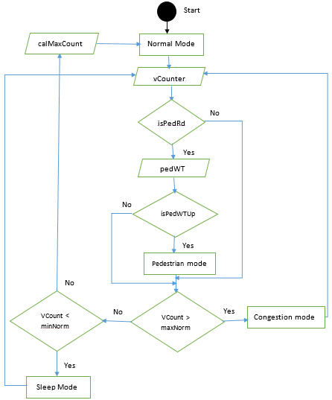
System Design – Flow chart
CCSE 2022
4

Slide 6
System Upgrade
Additional transition mode:
Emergency Mode - For emergency service vehicles
Using ultrasound sensors
Pick frequency of the siren as input
Compare with frequencies in dataset
Using Doppler effect (change in distance, change in frequency)
Check the intensity of frequency of sound
Switch ON/OFF the emergency mode
5
CCSE 2022

Slide 7
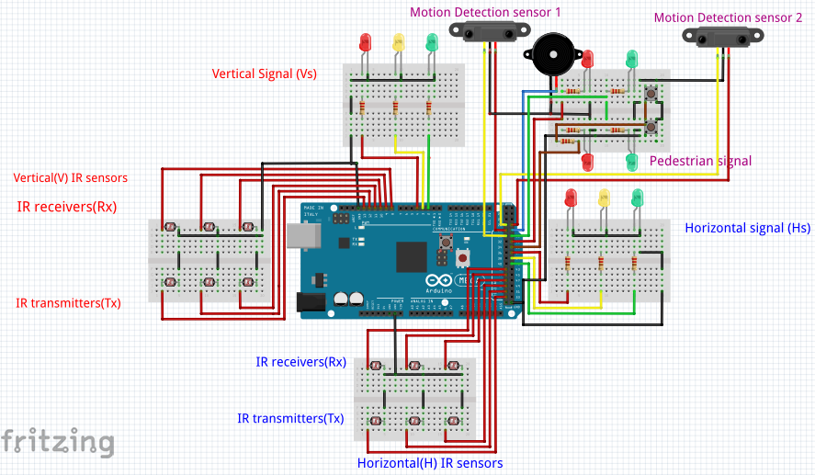
System Circuit Diagram
.
6
CCSE 2022

Slide 8
Summary
Causes of traffic congestion
Implemented solutions
Problem with existing traffic controllers (poor timing signal)
Solution to the problem (Smart Traffic Controller) - Dynamic
Feature enhancement of the smart controller (the emergence mode)
7
CCSE 2022

Slide 9
References
[1] Wikipedia, ”Traffic Congestion” available[online] ”https://en.wikipedia.org/wiki/Traffic congestion”. [2] U.S Federal Department of Transportation(FHWA), Office of Operations, ”21st century operations using 21st century technologies”, ”Operation Story” available[online] ”https://ops.fhwa.dot.gov/aboutus/ opstory.htm” archived ”https://web.archive.org/web/20080725055811/ http://www.ops.fhwa.dot.gov/aboutus/opstory.htm”. [3] Metropolia,”Infrared sensors” available[online]”https://wiki.metropolia.fi/display/sensor/Infrared+sensors”. [4] Arrow, ”The Right Tool for the Job, Active and Passive Infrared Sensors” available[online] ”https://www.arrow.com/en/research-and-events/ articles/understanding-active-and-passive-infrared-sensors”. [5] Wikipedia, ”PIR sensors”, available[online] ”https://en.wikipedia.org/wiki/Passive infrared sensor”. [6] Instructables,”PIR sensors” available[online] ”https://www.instructables.com/PIR-Motion-Sensor-Tutorial/”. [7] Store, ”Arduino Mega 2560 Rev3” available[online] ”https://store.arduino.cc/products/arduino-mega-2560-rev3”. [8] J. Fraden, ”Handbook of modern sensors. Physics designs and applications”, 4th edition. Springer, 2010. [9] Hexamite, “Ultrasound and Microcontroller Applications” available[online] ”https://www.hexamite.com/hetheory.htm”. [10] Wikipedia Article, ”Doppler Effect” available[online] ”https://en.wikipedia.org/wiki/Doppler effect” [11] OAI ”An analysis of the classical Doppler effect” July 2003 European Journal of Physics 24(5):497, DOI:10.1088/0143-0807/24/5/306 ”https://www.researchgate.net/publication/230982964 An analysis of the classical Doppler effect”
8
CCSE 2022

Slide 10
Thank you

Slide 11
Q & A

